Slide 1
Exhibit Builder
Plugin
By Tania Silva
LIS 654 -- Building Digital Libraries
Dr.Thomas Krichel

Slide 2
Description & Structure
The Exhibit Builder plugin allows you to publish online exhibits and special web pages that showcase a combination of digital objects in an Omeka archive with narrative text.
All Omeka exhibits follow the same structure.
Each exhibit contains sections.
Each section is comprised of pages that contain an assortment of items and text.
You may create as many sections and pages per exhibit as you like.

Slide 3
Activate & Configure
Go to site Settings
Click on the Plugins tab
Locate Exhibit Builder
Click “Activate”
Once activated, click the “Configure” button
You may designate the main Exhibits page as your homepage
You may choose how to order the exhibits by:
  Date Added
  Alphabetical
  Recent
Click “Save Changes”

Slide 4
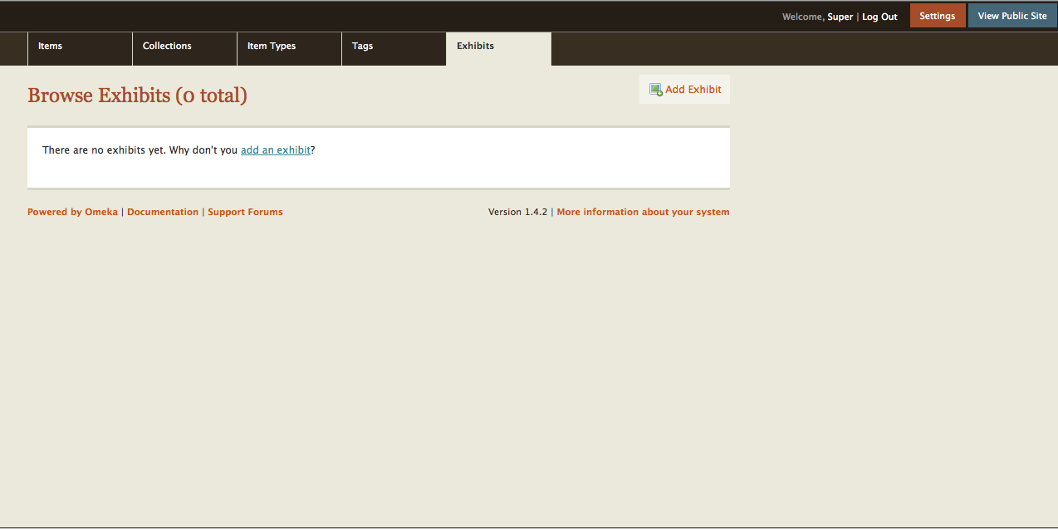
Building an Exhibit
Click on Exhibits tab in the top navigation bar of the /admin panel
Click the “Add Exhibit” button

Slide 5
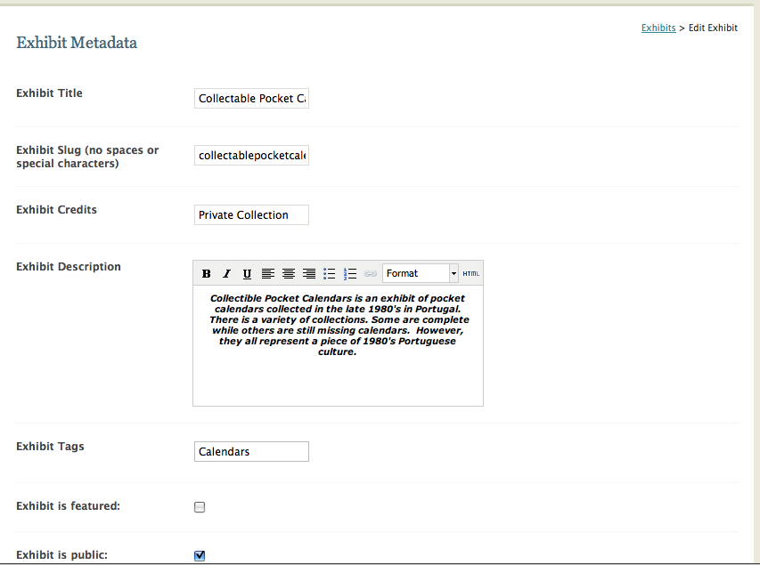
Exhibit Metadata Page
Exhibit name as it appears in the website URL
http://wotan.liu.edu/omeka/tisilva17/exhibits/show/collectablepocketcalendars
An introduction to the entire exhibit that appears on the main Exhibit page on the public site.
✓

Slide 6
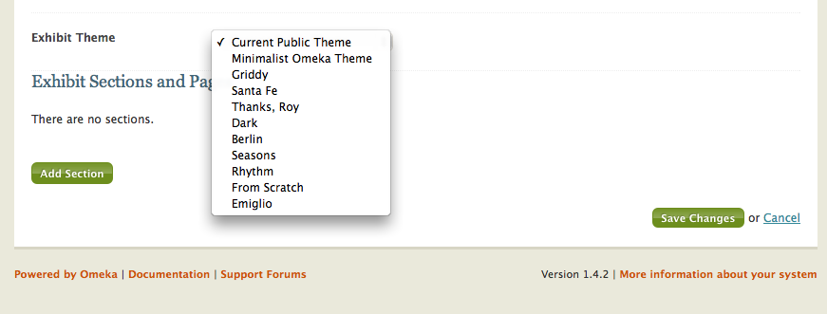
Exhibit Metadata Cont.

Slide 7
Add A Section
After clicking the “Add a Section” button, fill out the name you want to give to the section.
You can also fill in the URL slug and a short introduction or description of the section, however these are optional.
Click “Save Changes” and then click “Add a Page” to choose your page layout and start adding items to your collection.

Slide 8
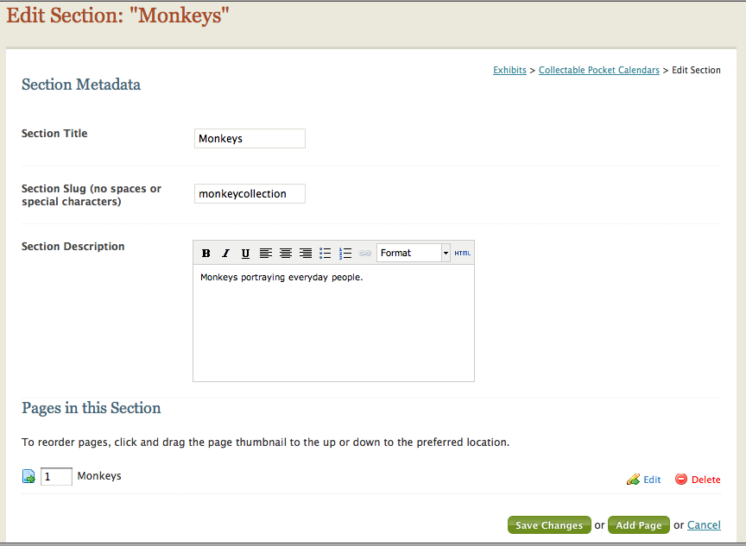
Add a Section

Slide 9
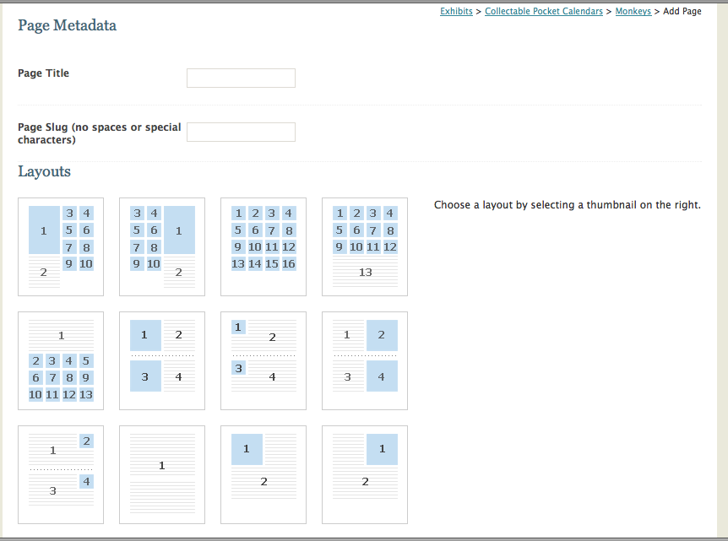
Page Layout
Give page a title and choose a layout

Slide 10
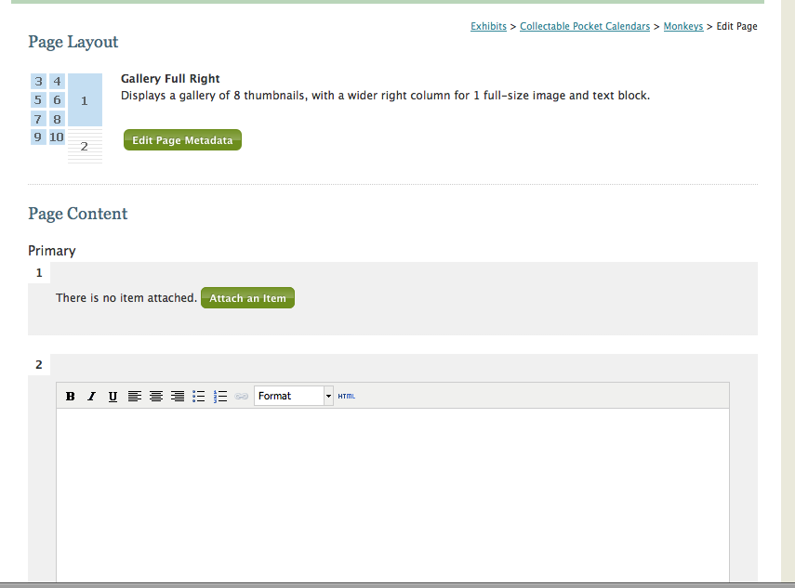
Add an Item
After choosing a layout, start adding items and text in their appropriate boxes in the template.
To add an item click the “Add an Item” button. A lightbox will appear with the archive’s items. Click on item you want to use and click the “Attach Selected Item” button on the bottom right corner.
Item is sent to page template where you can write an optional caption. You can also add text.
Don’t forget to save!!!

Slide 11
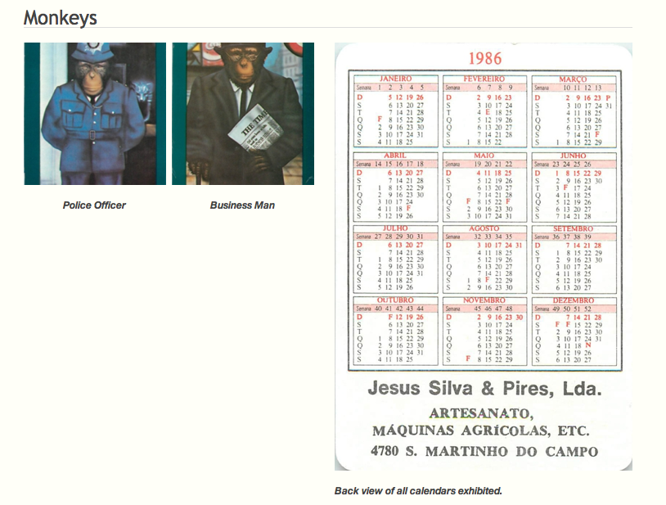

Slide 12
The End

