Slide 1
Plug-in Demo: Dropbox
Judith Schwartz
Fall, 2011

Slide 2
What is Dropbox?
Dropbox allows you to upload files in bulk rather then one at a time on the items page.
There are no file size limitations when using Dropbox.
Omeka doesn’t restrict file sizes: There may be file size restrictions from your hosting server as per Omeka Forums>File size limit
Dropbox plugin supports the creation of multiple items, and allows bulk creation of Tags, Collections, and Titles.
Other Dublin Core fields still need to be entered separately.
Notes:
Allows you to upload a large amount of data to your Omeka installation without worrying about the file size limitations when uploading from admin items interface.

Slide 3
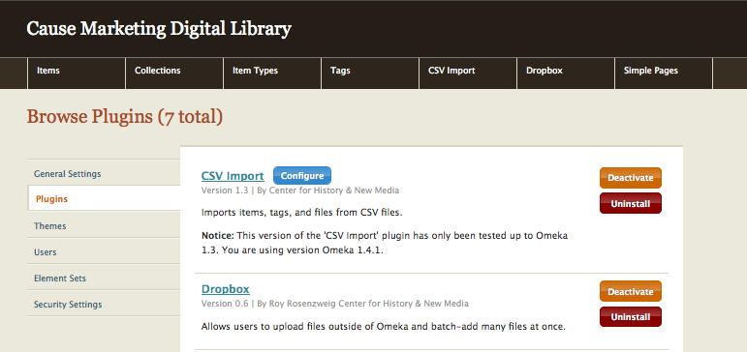
Using Dropbox
Install the plugin
Go to Manage Plugins • Dropbox. • This creates a primary tab on the top of the admin panel.

Slide 4
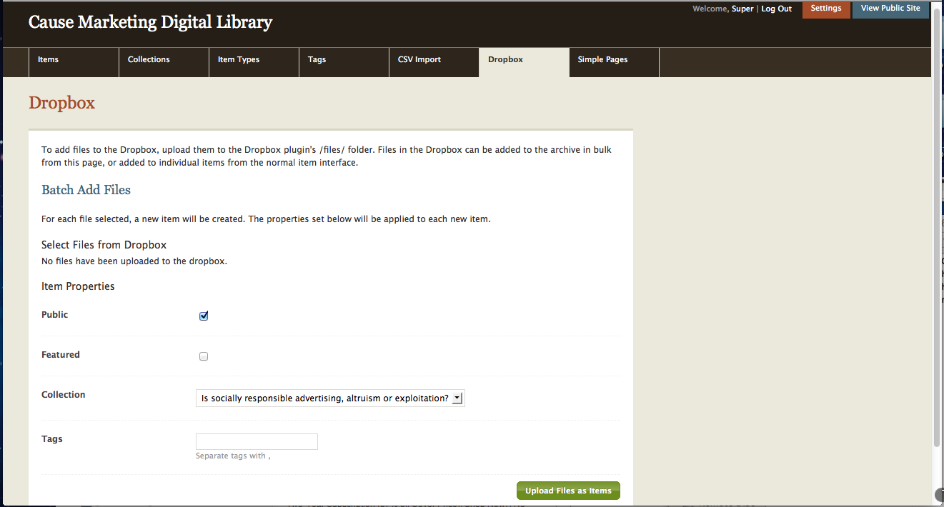
Using Dropbox
Click on top tab to access the Dropbox admin panel.
This is how it looks before you add files.

Slide 5
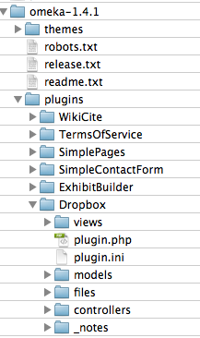
Using Dropbox
Go to Omeka folder >plugins>Dropbox>files
FTP your files to the files folder
*Note: this is a mac interface

Slide 6
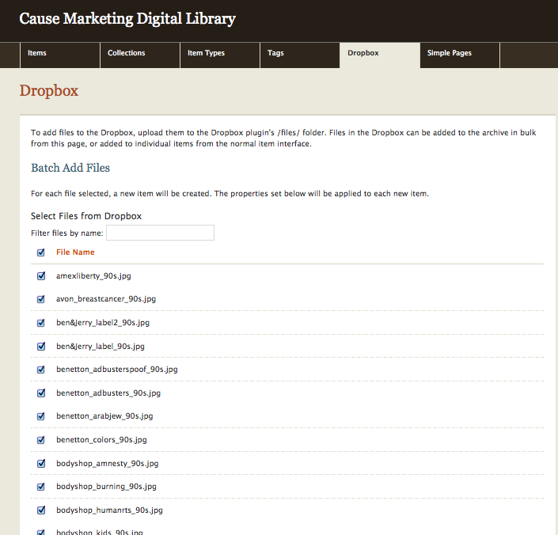
• Go back to admin panel.
• list of files appears.
• You have the ability to select them individually or in bulk.

Slide 7
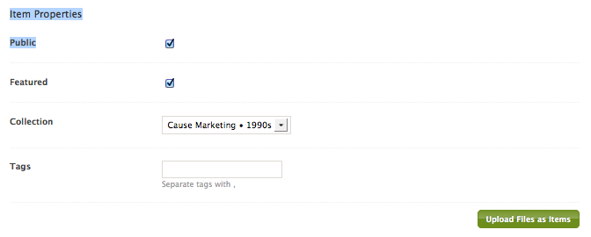
Using Dropbox
Choose the collection you are loading files to.
Click whether it’s public or featured, add tags if generic. (all of this can be modified later)
Click upload

Slide 8
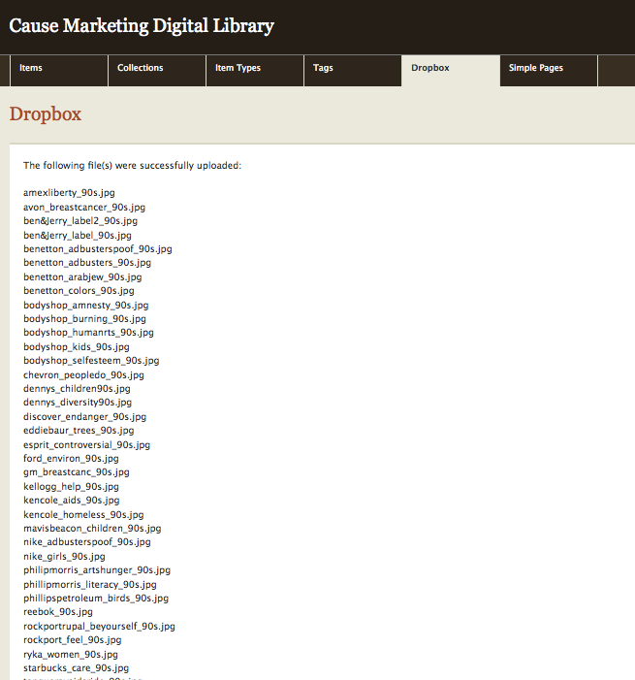
After files are uploaded, this message appears:
The following files were successfully uploaded…
Files appear to be alphabetical but come into Omeka
backwards (z-a)

Slide 9
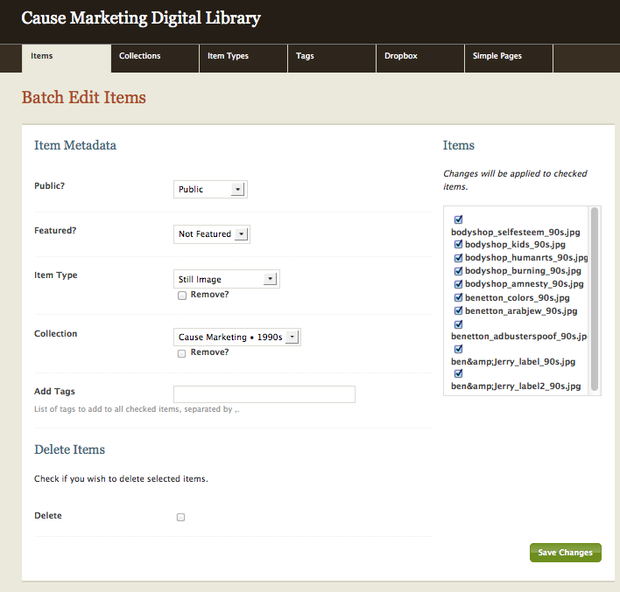
Go to “Items” tab to
edit items individually or batch edit, and to:
- add to Dublin Core fields
designate collection - add tags
modify title names from file names.
- change items to feature or public

Slide 10
Dropbox and CSV
Dropbox loaded the 40 files easily but…
You still need to enter the metadata manually.
CSV file is more efficient if you have a larger collection.
It’s more organized because info is saved in one document.
Create CSV spreadsheet - Upload images into Dropbox files folder - CSV “file” column will designate image path to Dropbox files for example: http://Judith@wotan.liu.edu/omeka/judith/plugins/Dropbox/files/IMG_0027.JPG

