Slide 1
The Simple Pages plug-in
Christina Bell
23 February 2012

Slide 2
Simple Pages
“Allows administrators to create simple web pages for their public site.”
Claims no knowledge of web development is needed.

Slide 3
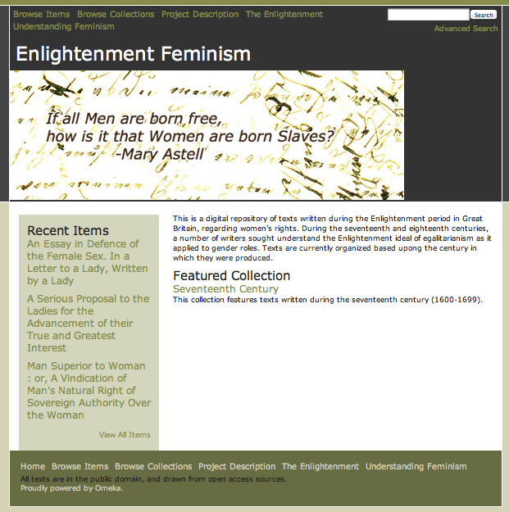
My Omeka Page

Slide 4
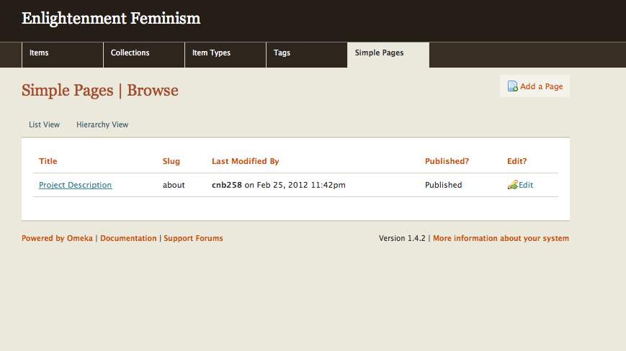
Simple Pages Admin

Slide 5
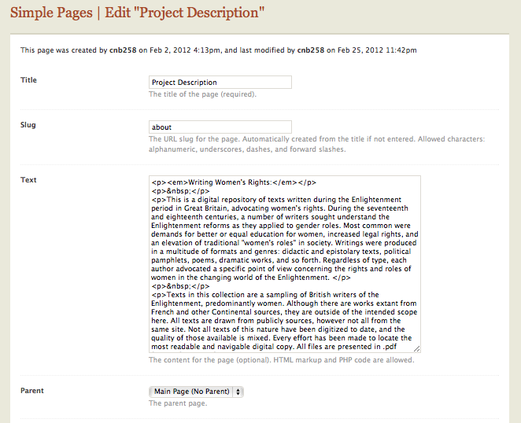
Simple Pages- edit view

Slide 6
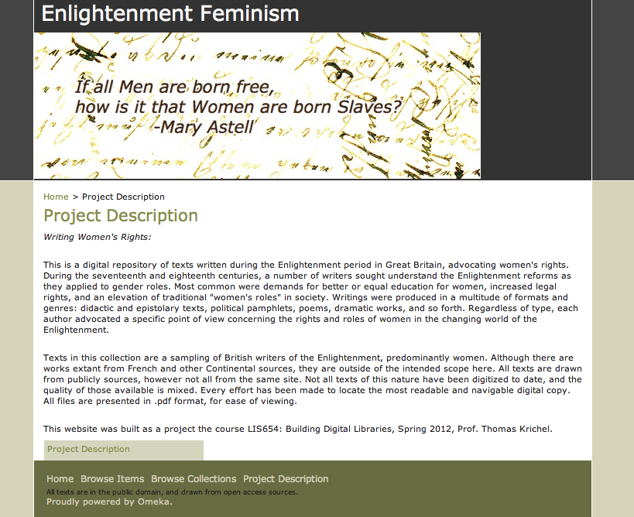
Published Version

Slide 7
Critique
This plug in is effective for producing easy, text based pages.
Some knowledge of HTML tags is needed- e.g. cannot bold or italicize text without the correct tags.
This plug in really only works with text- to display images, something like the Exhibit Builder would be better.

