Slide 1
Enlightenment Feminism
Christina Bell

Slide 2
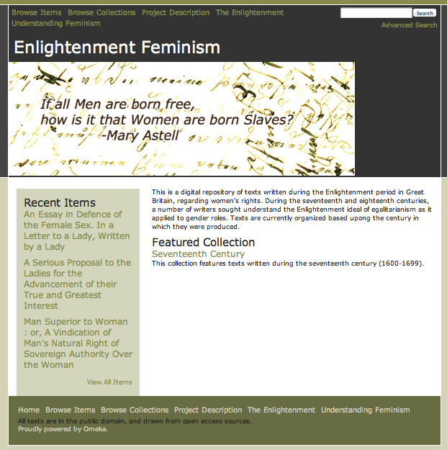
The Omeka site

Slide 3
About
This is a repository of texts written during the Enlightenment period (mid-seventeenth to late eighteenth centuries) regarding women’s rights. Modern feminist history often begins with the “first wave” movement, dated from Mary Wollstonecraft’s publication of The Vindication of the Rights of Women in 1792. While this work was definitive in advocating for equal rights and opportunities between the sexes, it was preceded by centuries of writing related in various ways to the rights of women. This digital library seeks to gather texts produced prior to 1792, written by both men and women in Great Britain, with both pro- and anti- feminist arguments.

Slide 4
Collections
At present, the repository is divided into two collections, based upon date of origin. That is, they are divided by century. I am still working to gather texts, and as the collection builds the collection(s) organization may change. All texts are from British authors, written in the seventeenth and eighteenth centuries.

Slide 5
Metadata
Dublin Core fields: creator, date, description, language, source, subject, title.
Additional: publication place, and gender of author, pro- or anti- feminist position.

Slide 6
Tags
Tags are vital to the organization of these texts. They allow for cross-collection organization, and enable the user to view texts organized based upon the other metadata elements than the strict collection definitions. This allows the user to customize their use of the repository as a whole, and define the organization of the texts by their own needs.

Slide 7
Plug-Ins
Simple Contact Form (not in use for security reasons).
Simple Pages
Library of Congress Subject Headings (not available)

Slide 8
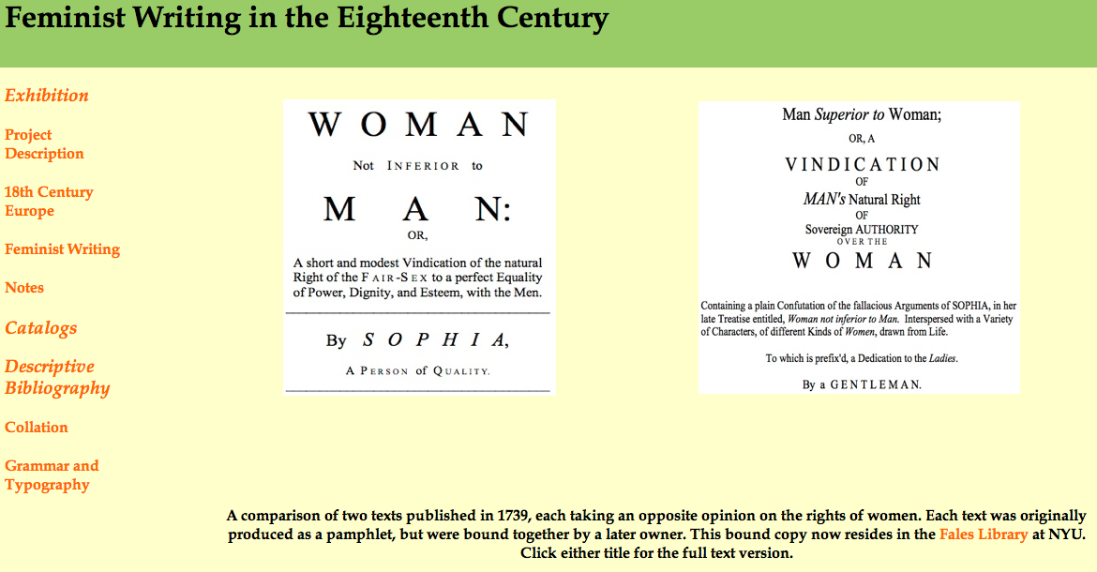
Companion Site

